Slide 1
24-27 May 2022
Welcome to the AESIS course on
Institutional Structures for Societal Impact of Science
#Instruc22

Slide 2
Institutional Structures for Societal Impact of Science
24-27 May, 2022
DAY 1
#Instruc22
@AesisNet

Slide 3
Institutional Structures for Societal Impact of Science
24-27 May, 2022
Introductions
Getting to know you
Embedding societal impact in your institution
Anika Duut van Goor, Director of AESIS
Susan Renoe, Associate Vice Chancellor, University of Missouri & Executive Director of the NSF Center for Advancing Research Impact in Society, USA
Institutional Readiness & Culture – Part I & II
David Phipps, Assistant Vice-President of Research Strategy & Impact, Office of Research Services, York University, Canada
Exploring the funding landscape
Britt Holbrook, Associate Professor in the Department of Humanities at New Jersey Institute of Technology, United States
Jess Miner, Executive Director of the Edmond J. Safra Center for Ethics, Harvard University, United States
Overview of Day 1
#Instruc22

Slide 4
Institutional Structures for Societal Impact of Science
24-27 May, 2022
Getting to know each other…
•Where do you stand in the science eco-system?
•Why are you here and what would you like to take away?
•Why is the topic of this course important (to you)?
#Instruc22

Slide 5
Institutional Structures for Societal Impact of Science
24-27 May 2022
How did we get here?
Notes:
I mentioned that it was always a part of the science view, but why is it now so prominent?

Slide 6
“…the real and legitimate goal of the sciences is the endowment of human life with new inventions and riches.” Francis Bacon, Novum Organum, 1620
“Science knows no country, because knowledge belongs to humanity, and is the torch which illuminates the world.” Louis Pasteur, French biologist & bacteriologist (1822 - 1895)
“Nothing in science has any value to society if it is not communicated, and scientists are beginning to learn their social obligations.” Anne Roe, the Making of a Scientist, 1953
“…science and technology is the warp drive that accelerates that kind of change [raise the fortunes of people] for everybody.” Barack Obama, Wired, 2016
Notes:
Seems to be overall consensus about the value and even responsibility of science to the whole of society. Sometimes accompanied by voices against this notion, from greek philosophers to ivory tower academics, worried that engagement with or focus on the public will distract and stain the research.

Slide 7
Thanks to Esther de Smet Source: Academia Obscuro – Glen Wirght
Notes:
Stole this from Esther de Smet
Academia Obscura: The Hidden Silly Side of Higher Education
By Glen Wright

Slide 8
Institutional Structures for Societal Impact of Science
24-27 May 2022
Science ↔ Society
In the 20th century
Industries involving academics when necessary
Contract research & technology transfer (TTO’s)
Entrepreneurship, Scienceparks

Slide 9
Institutional Structures for Societal Impact of Science
24-27 May 2022
Science ↔ Society
Which meant
Transfer of new technologies to the market: Contract research, Patents & Licenses, Start-ups
Market demand is often clear
Input from research is often tangible
Outcomes often quantifiable
TTO’s well organised

Slide 10
Institutional Structures for Societal Impact of Science
24-27 May 2022
Science ↔ Society
The shift…
dissatisfaction with publication models
demand for openness of science & innovation
policy interest in mission- and challenge-driven research
importance of research for broader impact
Notes:
Why is number of publications or citations a measurement for quality?
Broader impact: future employment, competitiveness, growth, well-being and policy-making
Equality, health, climate

Slide 11
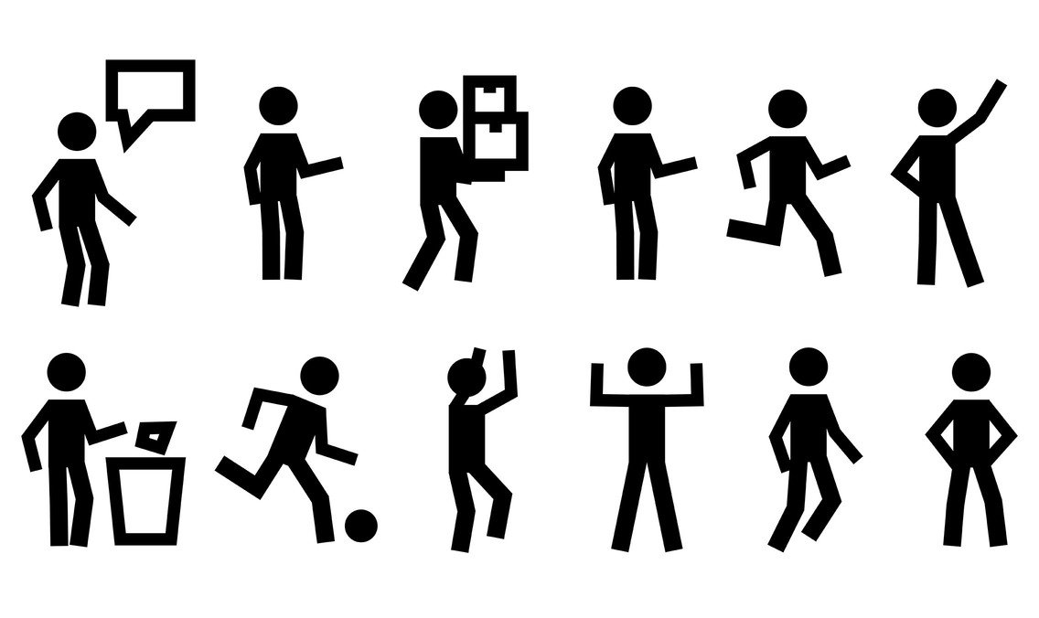
Institutional Structures for Societal Impact of Science
24-27 May 2022
Science ↔ Society
In the 21th century
Accountability for funding all science
From Economic to Societal Impact
Integration, not add on. Transformation.
Labels: TT, KT, KE, KEC, 3rd Thing (arm, leg, mission)

Slide 12
Institutional Structures for Societal Impact of Science
24-27 May 2022
Science ↔ Society
Shift to societal impact focus meant
Society at large, even directly
It’s about people & quality of life
By all scientific disciplines
Multiple stakeholders
…
Notes:
Impact is much broader and more vague

Slide 13
• Facilitators •
• Businesses •
• KTO’s •
Industry
Government
Citizens
• Management •
Knowledge Transfer & Business development
• Startup’s •
• Funding agencies •
Universities
and other Research institutions
• Research Councils •
• Policy makers •
Science
Data & Evidence
for Policy
Society
• Science policy makers •
• Researchers •
• Societal organisations •
Knowledge Exchange & Dissemination
• Administrators •
• Media •
• Scientometricians •
• Consumers •
• Evaluators •
• Investors •
Notes:
The impact-landscape as a whole – just a smidge of the types of stakeholders you could possibly contact/work with

Slide 14
Institutional Structures for Societal Impact of Science
24-27 May 2022
Science ↔ Society
Shift to societal impact focus meant
Society at large, even directly
It’s about people & quality of life
By all scientific disciplines
Multiple stakeholders
Vast number of impact-pathways
Notes:
Impact is much broader and more vague

Slide 15
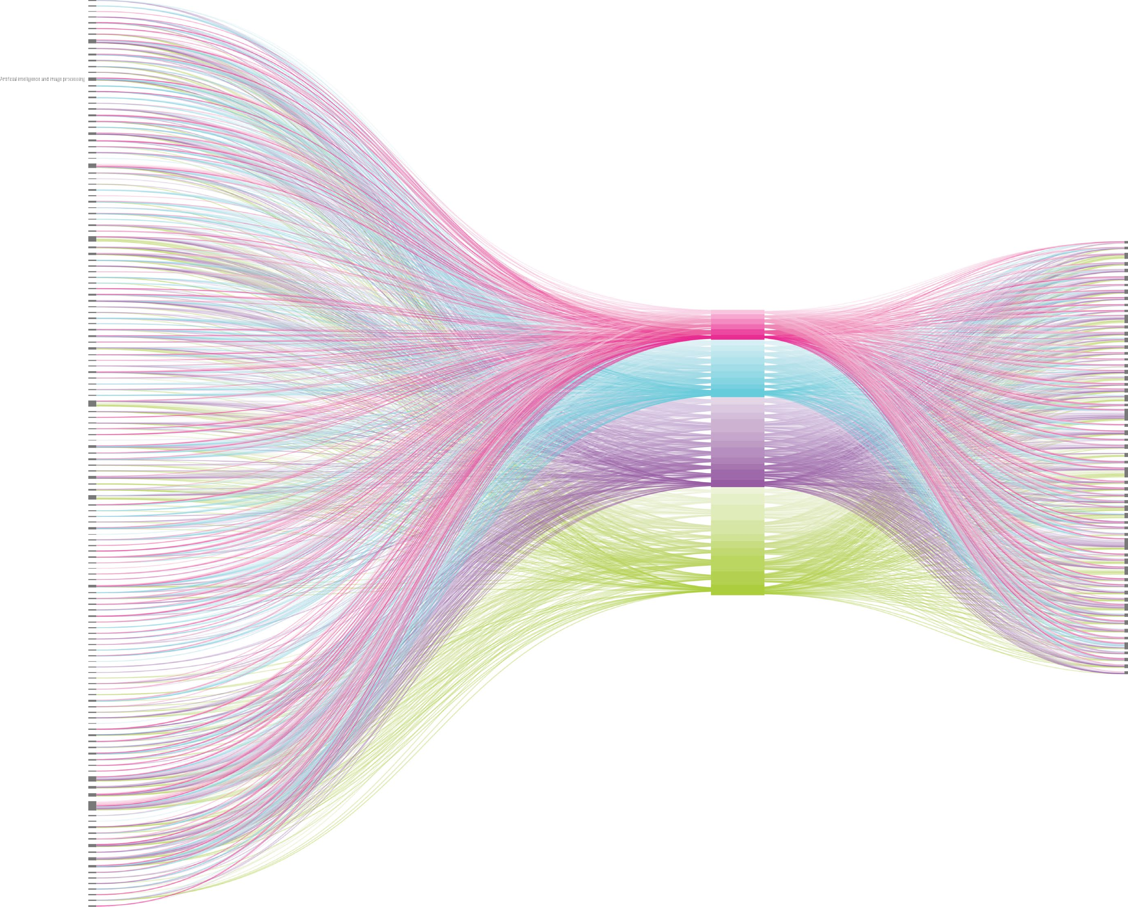
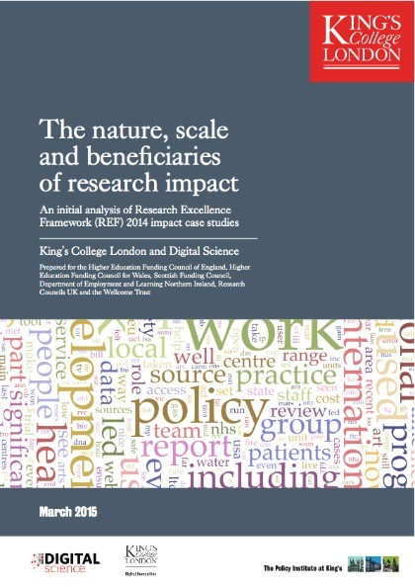
Institutional Structures for Societal Impact of Science
24-27 May 2022
Why assessing is difficult
King’s College London and Digital Science. (2015). The nature, scale and beneficiaries of research impact. An initial analysis of Research Excellence Framework (REF) 2014 impact case studies. HEFCE.
Notes:
Submitting impact case studies, a certain quota per university for REF. mpact as integral part of what researchers do
Left: fields they came from. Right are the fields that are impacted
Also: Two-thirds of the research related to impact case studies involved two or more disciplines

Slide 16
Institutional Structures for Societal Impact of Science
24-27 May 2022
Science ↔ Society
Shift to societal impact focus meant
Society at large, even directly
It’s about people & quality of life
By all scientific disciplines
Multiple stakeholders
Vast number of impact-pathways
Mismatch between impact-ambitions and evaluation systems
Notes:
Impact is much broader and more vague

Slide 17
Institutional Structures for Societal Impact of Science
24-27 May 2022
Science ↔ Society
So more emphasis on…
reviewing merit & promotion criteria
developments of digital tools and metrics monitor uptake of research beyond academia
supporting (infra)structures for scientific impact
Training and skills for researchers

Slide 18
Institutional Structures for Societal Impact of Science
24-27 May 2022
Defining Societal Impact
Difficult to operationalise
Differences per discipline
Differences per sector
Differences per stakeholder
Differences per (national) context
More labels: Valorisation?, Economic & Societal Impact, Outcomes, Broader Impact, Knowledge mobilization, …
Notes:
Branches of societal impact (the labels) even talking about other things like public engagement science communication and open science. But how do we stay on course and define the whole of societal impact

Slide 19
Institutional Structures for Societal Impact of Science
24-27 May 2022
Defining Societal Impact
An effect on, change or benefit to the economy, society, culture, public policy or services, health, the environment or quality of life, beyond academia
REF
Research impact is the contribution that research makes to the economy, society, environment or culture, beyond the contribution to academic research
ARC
Notes:
Beyond academia, absolutely true in my view
Contribution implies “something that you do to help produce or achieve something together with other people, or to help make something successful. Now obviously that is what the goal is, but the question is if an objective definition of impact is actually always positive. What about grimpact? Innovations from which certain communities will flourish and others will suffer. Or is this not something we should decide upon, because the eventual impacts on society are determined by the way it is implemented and that is not something you need to worry about? (Just saying something maybe a bit controversial, what do you think?

Slide 20
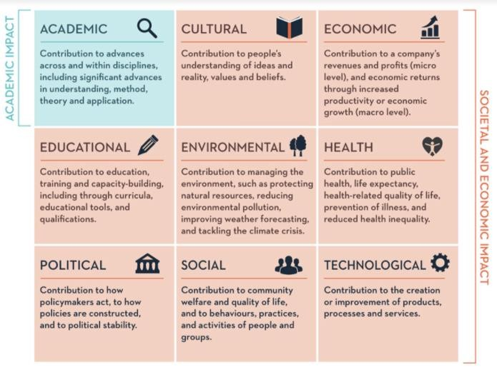
Institutional Structures for Societal Impact of Science
24-27 May 2022
Defining Societal Impact
https://www.ucd.ie/ impacttoolkit/whatisimpact/
Notes:
Great resource
Imagine how many different types of impact you can have with research. Actually the societal impact is much more vast and diverse
Also, you can have an impact in multiple of these with the same research: increase in company income + cleaner more sustainable work

Slide 21
Reach → Beyond academia → Regional, National, International Demonstrable → Long term impact (fundamental research) → Indirect impact (interdisciplinary) Interpretation → Different for every stakeholder → Positive/negative/no change
Institutional Structures for Societal Impact of Science
24-27 May 2022
Considerations for defining impact

Slide 22
Institutional Structures for Societal Impact of Science
24-27 May 2022
Defining Societal Impact
What about your organisation?
Notes:
How do we feel about this?

Slide 23
Institutional Structures for Societal Impact of Science
24-27 May 2022
Accepting Impact
Varied: in disciplines and topics
Can be direct and/or indirect
Difficult to monitor/demonstrate
Lags in time
Notes:
Indirect: in societal phase (unintended) or interdiscipl
Lags in time: 17 years from research to impact: that’s not true. 1. the article was talking about biomedical research and concluded average 15-25 years. And 2, things can change (see covid) apparently if the urgencies is high and collaboration structures build on trusting relationships already exist. 3. it depends on discipline

Slide 24
Policies in the world… (EXPAND)
UK Research Excellence Framework (TEF & KEF)
EU Societal challenges – HorizonEurope
Netherlands Nationale Wetenschapsagenda, Topsectoren, SEP
Canada Knowledge Mobilisation, EDI
USA Broader impact, inclusive education
Australia Chief Science Advisors, ERA & EI
Poland REF-like, but per discipline
South Africa National Impact Framework (NRF)
And many more…

Slide 25
Institutional Structures for Societal Impact of Science
24-27 May 2022
Integral part: assessing impact
Analysis To understand why, how and whether research is effective, and how it can be better supported.
Advocacy ‘makes the case’ for research funding among policymakers and the public
Accountability Evidence efficient use of resources to taxpayer, donors, partners, etc…
Allocation How to distribute funding (institution, field, people …)
Acclaim Compare and recognise value of HE institutions
Adaptation Steer change in structures, cultures, activities and priorities
Source: Parks, Sarah, Daniela Rodriguez-Rincon, Sarah Parkinson, and Catriona Manville, The changing research landscape and reflections on national research assessment in the future. Santa Monica, CA: RAND Corporation, 2019. https://www.rand.org/pubs/research_reports/RR3200.html.
Notes:
Analysis To understand why, how and whether research is effective, and how it can be better supported. Advocacy To demonstrate the benefits of supporting research, and enhance the understanding of research and its processes among policymakers and the public. Allocation To determine how to distribute funding across the research system. Accountability To evidence that money and other resources have been used efficiently and effectively, and to hold stakeholders to account. Acclaim To compare and recognise the value of higher education institutions and the research conducted within them. Adaptation To steer change in organisational structures, behaviours and cultures, and research activities and priorities.
Questions?

Slide 26
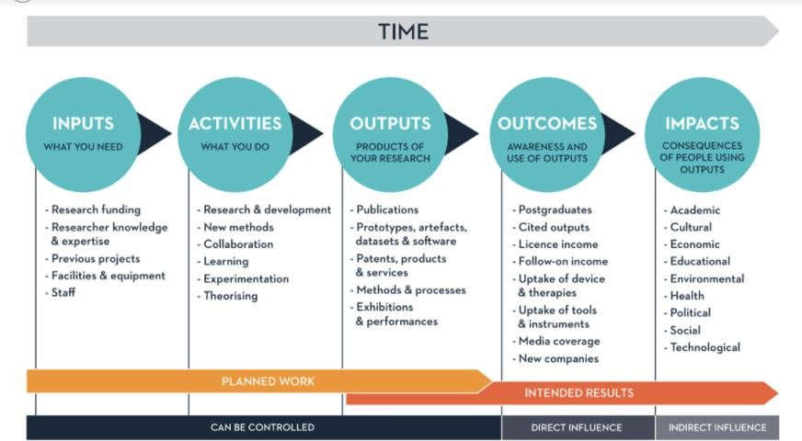
Institutional Structures for Societal Impact of Science
24-27 May 2022
Impact process
University College Dublin - https://www.ucd.ie/impacttoolkit/whatisimpact/
Notes:
Important to understand the different concepts
Also: Impact planning canvas (Europe, Toni will tackle
Sphere of Control, Sphere of influence, Sphere of interest

Slide 27
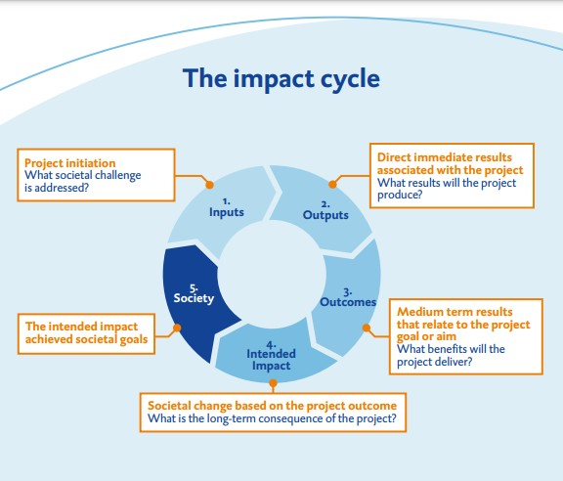
Institutional Structures for Societal Impact of Science
24-27 May 2022
Impact process
University of Groningen Medical Center https://www.umcg.nl/SiteCollectionDocuments/English/Research/Impact/impact-cycle.pdf
/
Notes:
Important to understand the different concepts
Also: Impact planning canvas (Europe, Toni will tackle

Slide 28
Institutional Structures for Societal Impact of Science
24-27 May 2022
Possible impacts
Stronger economy
New companies
Exports
Jobs
Stronger society
Better Health
Better Education
Inequalities
Poverty
Unemployment
Social care burden
Crime/violence/terrorism
Pollution
Climate change
Notes:
On the left more the focus in the last century, now increasingly the right side

Slide 29
Institutional Structures for Societal Impact of Science
24-27 May 2022
Impact process
University College Dublin - https://www.ucd.ie/impacttoolkit/whatisimpact/
Notes:
Important to understand the different concepts
Also: Impact planning canvas (Europe, Toni will tackle

Slide 30
Quantifiable indicators (REF/SEP/etc)
Institutional Structures for Societal Impact of Science
24-27 May 2022
Demonstrating impact
The citations of science in the parliament
The scientific advisory functions in government
The citations of science in main newspapers/daily news
Contract research
Policy reports
Articles in professional journals for non-academic readers
Public prizes
Other outputs (instruments, infrastructure, datasets, software tools or designs that the unit has developed) for societal target groups

Slide 31
Qualitative/Narratives
Institutional Structures for Societal Impact of Science
24-27 May 2022
Demonstrating impact
Public awareness, attitude or understanding of risks improved
Quality or productivity of professional or public service improved
Public health or quality of life improved
Project lowered risks to security
User experience has improved
Changes in environmental or architectural design standards or general practice
Development of ethical standards
Professional research capabilities improved
Project challenged conventional wisdom, stimulating debate among stakeholders
Improved access to justice and other opportunities
Impact on democratic participation
Creating, inspiring or supporting new forms of expression (like artistic, literary etc.)
Understanding, developing and adopting alternative economic models
Etc…

Slide 32
Institutional Structures for Societal Impact of Science
24-27 May 2022
Impact process
University College Dublin - https://www.ucd.ie/impacttoolkit/whatisimpact/
Notes:
Important to understand the different concepts
Also: Impact planning canvas (Europe, Toni will tackle

Slide 33
Research uptake People are interested in research, read it, talk about it, go to a presentation or event, etc
Institutional Structures for Societal Impact of Science
24-27 May 2022
Output – Outcome – Impact
Research use
People do something with the research, maybe change a bit of their view, pass it on, apply it to practice or policy
Research impact
A contribution to change as a result of the research usage
Source: Matter of Focus (Sarah Morton)
Notes:
Uptake is getting people interested, when there is interaction
Use is when it is applied in some way
Impact is when actual change takes place
Get the processes right, then the rest are more likely to come

Slide 34
Why would researchers focus on impact

Slide 35
Expectations Making a difference Performance assessment Responsibility
Why focus on impact
Notes:
Funder expectations: European funding, impact pillar, dissemination, exploitation elements

Slide 36
Enough reasons, what’s the challenge?
Survey by Bonita Liu on researchers and PE
Willingness
Activities timeline
Intention
Attitude
Self efficacy
Notes:
• Communicated with the public about my research via social media
• Written a book/books about my research for the public
• Written an article/articles about my research for the public
• Engaged with policy makers as a scientist through my research
• Engage with non-government organizations as a scientist through my research
1. willingness scores are higher than intention scores in general, regardless of when public engagement activities are set to occur
2. a more positive attitude and higher sense of self-efficacy towards PE predicts higher willingness for PE activities regardless of when PE activities are set to occur
3. a more positive attitude and higher sense of self-efficacy towards PE are predictive of intention rto seek out PE activities occurring in a year's time, but lose predictive power for activities occuring in a week's time

Slide 37
Overcoming them
When changing:
Skills Resources Perspectives

Slide 38
On the project level - impact pathways
Contexts | What are the wider environmental, political, social, technological, legal and/or economic contexts to which your research may be relevant
Communities | Who are the communities and beneficiaries of your research?
Constituencies | Who has a (positive) interest in your project and can influence change?
Challenge | What is the situation, and challenge, you will solve through your research questions?
Channels | What approaches will you use to reach those constituencies?
Communication | What is the appropriate style, tone and structuring needed to get your main message across?
Capture | How will you demonstrate your impact?
Sreenan, N., Hinrichs-Krapels, S., Pollitt, A., Rawlings, S., Grant, J., Wilkinson, B., ... & Kinloch, E. (2019). Impact by design: Planning your research impact in 7Cs. Emerald Open Research, 1(18), 18.
Notes:
What should researchers think about to design impact into their research project
don’t get siloed, use the staff
Who (just benefit?) is it a specific group? Or broader? Institutional level? Individual level?
Finding key champions for your research
Really base this on the community and context? Integrate that in own research question
Advisory boards, social media
Communication strategy, finding the tone/language
Likes of blogs, newspaper clippings
All of these are really important when finding and describing your impact pathways
Use the supporting staff:
For stakeholder mapping
Existing relationships
Communicating non-academic
Other support

Slide 39
Skills needed – what is there, what is needed, what is feasible?
Notes:
Researcher, internal, external?
How to fuel this:
Starting discussions, setting up focus groups
Creating webpage with impact-related documents - Research Impact Toolkit
Assigning Impact Leaders among the faculty members
Using the Impact Planning Canvas methodology
Collection of Impact Case Studies, short videos
„Break it into digestable parts” (UCD) - Research Impact Cycle
Celebrate and showcase success
Research impact competition
Adding impact perspectives in researcher performance evaluation
Encourage co-production
Advise to do stakeholder mapping
Teach/encourage non-academic communication: ‘Turn your paper on its head’, infographics, policy briefs, social media
Have a pathways to impact support service
How research managers can support impact:
inform, educate and create awareness about the impact of research and collaborations beyond academia. - developing and identifying tools and resources to support with impact planning and evidencing
working collaboratively across the University and with external partners to support impact
managing the development and delivery of the University’s impact strategy by providing input, comprehensive advice, support and analysis to researchers during the development of their research.
leading the development of impact case studies and support research-active staff in improving the outcomes of their research, and specifically in improving, recording and demonstrating the impact of their research.
overseeing and developing systems and processes that support acquisition, collation and analysis of data regarding the impact of the University’s research of impact.
providing input into policy consultations and other discussions of strategic importance to the future direction of research impact
assisting with the preparation of the impact sections of research grant proposals in order to ensure it conforms to the evaluation criteria of the specific funding agency
proactively advising on all aspects of research impact to individual academics, heads of departments, the faculty research committee as well as the chair of the board of the faculty conducting the research
Excerpts from RMA job announcements and descriptions (by Borbála Schenk)

Slide 40
Institutional Structures for Societal Impact of Science
24-27 May 2022
Institutional change
Mission
Strategy
Implementation
Evaluation
Notes:
This is a very simple scheme of the process within any institution, and each phase requires attention when improving your impact of SDGs. An institution starts with a mission, builds a strategy based on the mission, the strategy is implemented and executed, the outcome is evaluated in one way or another and this will (or should be) connected back to your original mission

Slide 41
Institutional Structures for Societal Impact of Science
24-27 May 2022
Mission
What is the current situation?
In relation to other (competing) regional, national & international players?
What are strength and weaknesses?
How does this compare to the mission of your institution, as a whole and perhaps for separate departments?
Notes:
Most of you are not in the position to adapt, adjust or change a mission, but what you can do is determine to what extent the current performance matches the mission of your institution, or perhaps even your department or programme.
THE also helps with: position in relation to other (competing) regional, national, international players
THE ranking outcome helps define current situation: what are current strengths and weaknesses, the organization’s scale and influence, core competencies (not possible or preferable to deviate from too much) So looking at your current mission and the data that you are aware of, does your institution’s performance match the mission? If not, what is the biggest weakness?
IF you are in the position to adjust/adapt your mission, do you want to be broadly focused or specialise
Use the ranking and internal data to help further improve your profile.

Slide 42
Institutional Structures for Societal Impact of Science
24-27 May 2022
Mission
Strategy
Implementation
Evaluation
Notes:
Next phase is strategy

Slide 43
Institutional Structures for Societal Impact of Science
24-27 May 2022
Strategy
Where should you start? What are the priorities and reasonable timelines?
Who needs to be on board to get started?
How can room, time and capacity be created?
Notes:
The difference between mission and strategy! Don’t be vague and stick to what you want, but how you want to achieve it!
Where do you start? Set priorities, timelines What would the priority, the first step have to be in your institution or department (limited to what’s in your power)
Who needs to be on board to get started (show the positive impact and economic returns on social and environmental investments)
Create room, time and capacity

Slide 44
Institutional Structures for Societal Impact of Science
24-27 May 2022
Mission
Strategy
Implementation
Evaluation
Notes:
Rewritten your strategy, move on to implementation phase

Slide 45
Institutional Structures for Societal Impact of Science
24-27 May 2022
Implementation
Internal infrastructure
What skills and talents are needed for impact?
What facilities are required?
What incentives can be used?
How can internal/interdisciplinary collaboration be strengthened to increase excellence and impact?
Notes:
Improving internal infrastructure
What skills are needed
What facilities are needed (incubator/holding/science communication/research parks)
do you want to make your researchers project managers, entrepreneurs, etc, or do you offer facilities through scienceparks/sciencecommunication teams to make it happen)
- Incentives to engage faculty departments, administrative units and researchers (promotion, hiring)
- Internal/interdisciplinary collaboration (Emphasize the role of SSH)

Slide 46
Institutional Structures for Societal Impact of Science
24-27 May 2022
Implementation
External infrastructure
Which relevant players in and outside academic world are there? Which relations already exist?
Which format should the types of relations have?
What is the value for others to work with you?
What are the stakeholders’ concerns and aspirations?

Slide 47
Institutional Structures for Societal Impact of Science
24-27 May 2022
Mission
Strategy
Implementation
Evaluation
Notes:
This is a very simple model of any institution, and each phase requires rethinking

Slide 48
Institutional Structures for Societal Impact of Science
24-27 May 2022
Evaluation
Collecting data takes time…
But collecting data is extremely relevant in general for succeeding in your mission, strategy and execution
Making this data visible can also increase motivation (internally) and attractiveness (externally)
Notes:
THE might take time but data is relevant in general (“naming and faming” people in the organization who have made a difference nudges behavior)

Slide 49
Institutional Structures for Societal Impact of Science
24-27 May 2022
Mission
Strategy
Implementation
Evaluation

Slide 50
Examples of what researchers & staff can do to have impact
• Advisory panels
• Social media
• Policy briefs, leaflets, website
• Creating committees
• Institutionalise structures (Policy labs)

Slide 51
What do we need?
Four “I”s of Research Impact
Investing in impact
Incentives
Intermediaries
Infrastructures
ALIGNMENT
Source: David Budtz Pedersen, Humanomics Centre, Aalborg University, Denmark.
Notes:
INVESTING IN IMPACT. Alignment of mission statement and impact strategy (‘theory of change’) at university & funding agency level.
INCENTIVES. Without emphasis on incentives, recognition and rewards, most societal impact activities will not occur.
INTERMEDIARIES. Professional support and specialist skill-sets, training and needs to be cultivated and provided by knowledge brokers.
INFRASTRUCTURE. Reliable and responsible impact assessment depends on data about impact to learn from best practices and shape new strategies

Slide 52
Reflecting at your I’s – are they aligned?

Slide 53
Connecting stakeholders
These stakeholders don’t want a lot of information. Keep them satisfied but do not overwhelm them. E.g customers | Keep them fully engaged. More resources should be allocated to keep them satisfied. E.g owners
Don’t bore them with too much information. Be aware of and monitor them. Eg. | Remain adequately informed, helpful with the detail of a project. It may be good to continually check to ensure no issues are arising
High
Power
Low
Interest
Low High
Effort should be placed on the highest priority groups whiles developing strategies to keep the less powerful groups happy.
Notes:
Neil Flemming

Slide 54
You are not alone
Impact is not created by individuals but by collectives (building teams and interdisciplinarity)
Partnerships and networks are for creating a strong uptake environment, even more when urgent (see response pandemic)
Notes:
Response capacity changed during pandemic; input was immediately necessary. Standing on the shoulders of accumulated research, but no waiting for peer-review, presence of uncertainties

Slide 55
Challenge driven approaches
Multi-dimensional challenges require multi-disciplinary solutions

Slide 56
Exercise
Infrastructure
Policies
Strategies
Facilities

Slide 57
And now?
What’s the next step?

Slide 58
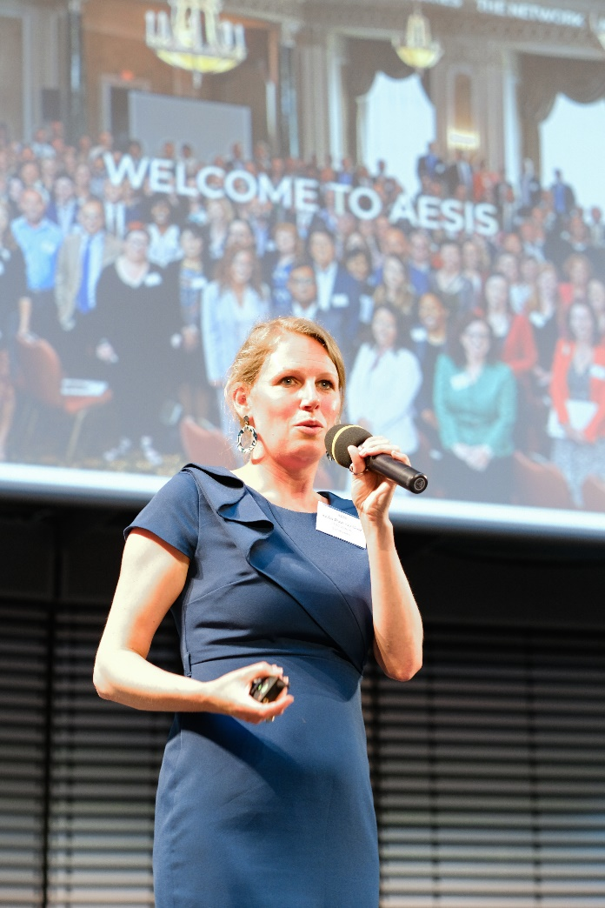
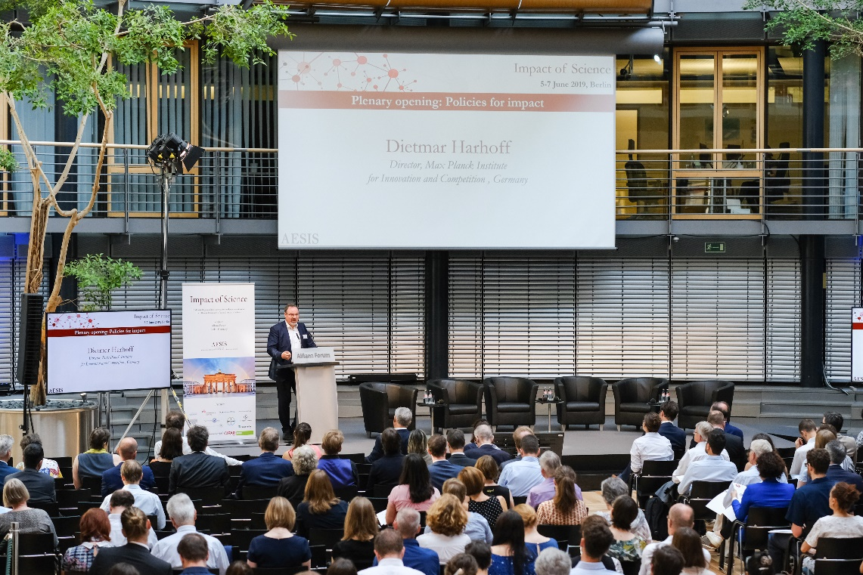
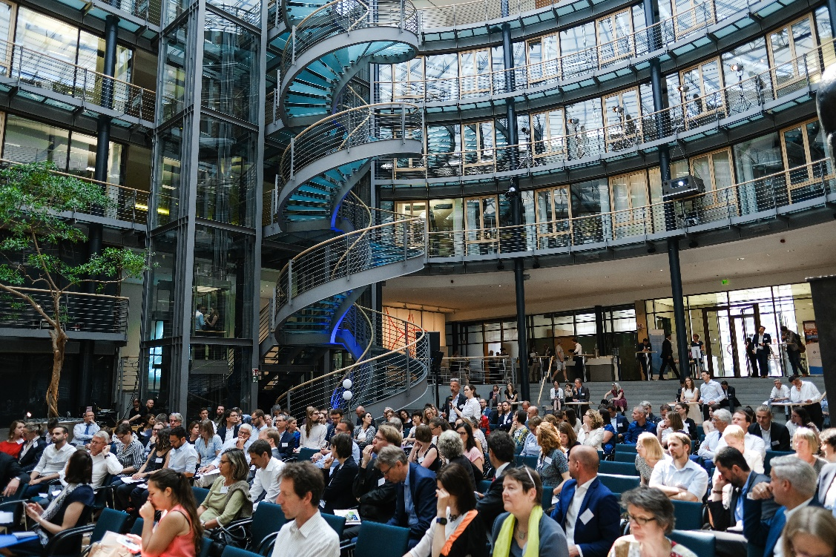
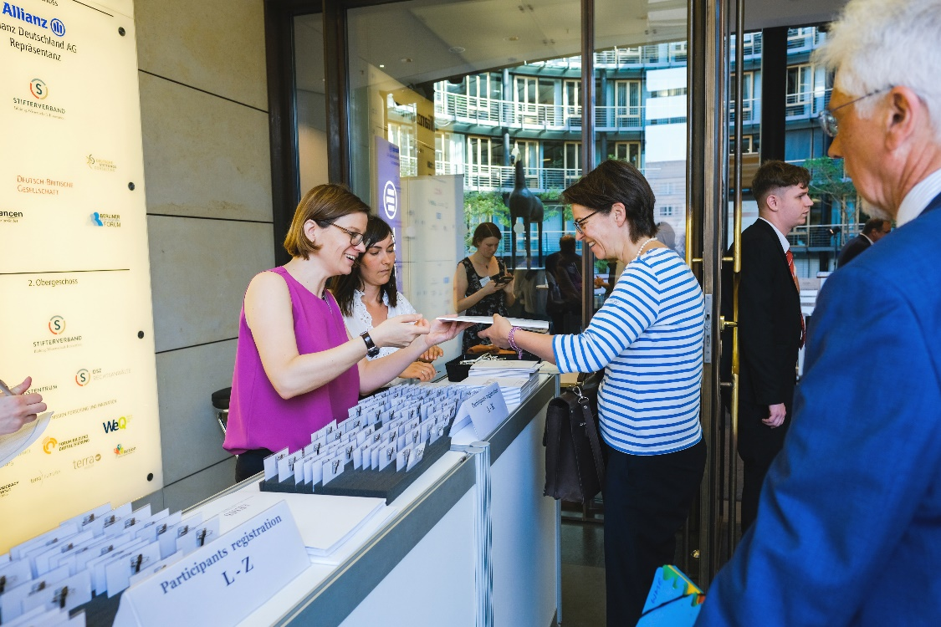
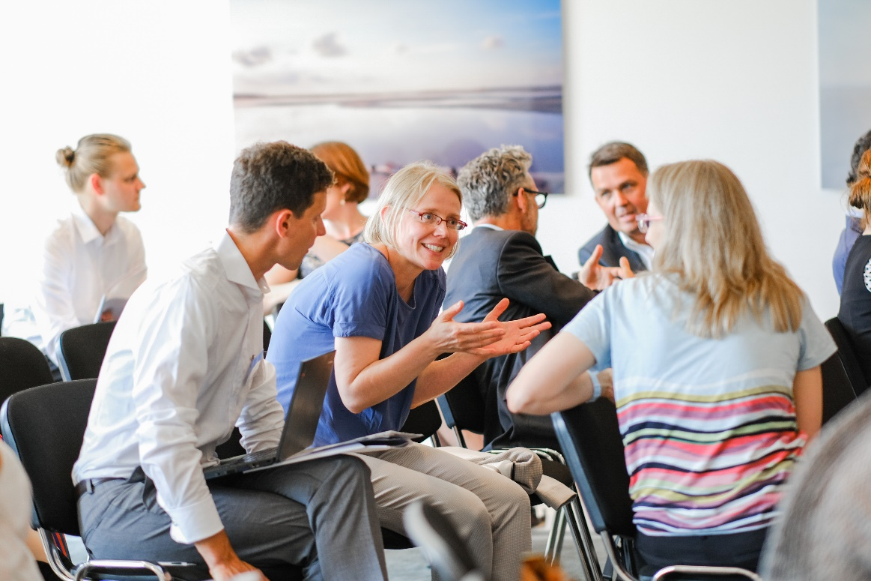
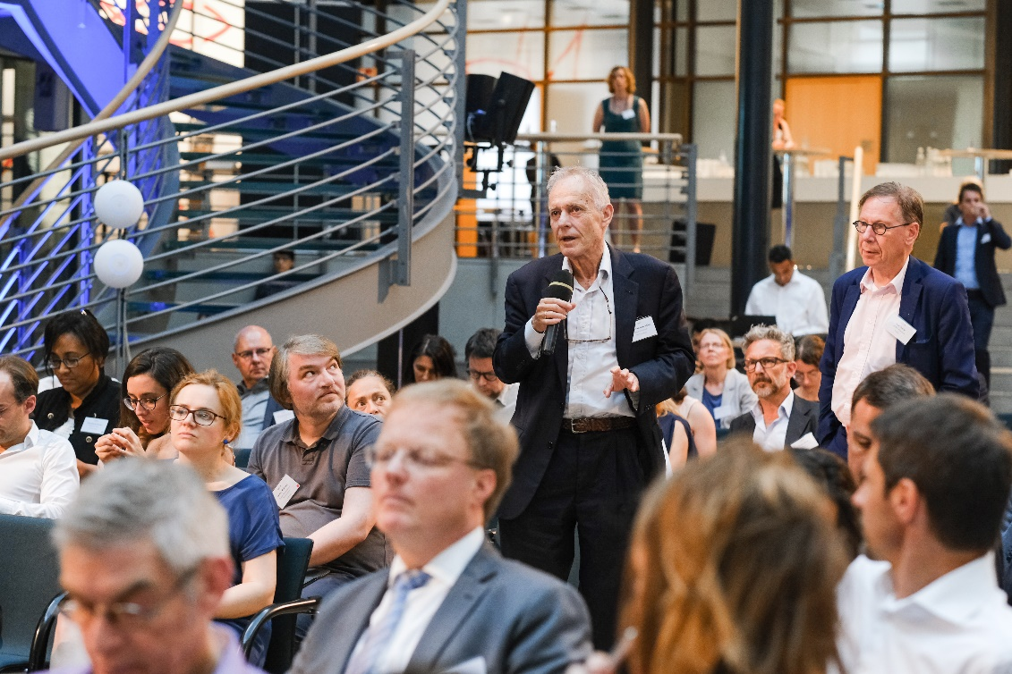

Slide 59
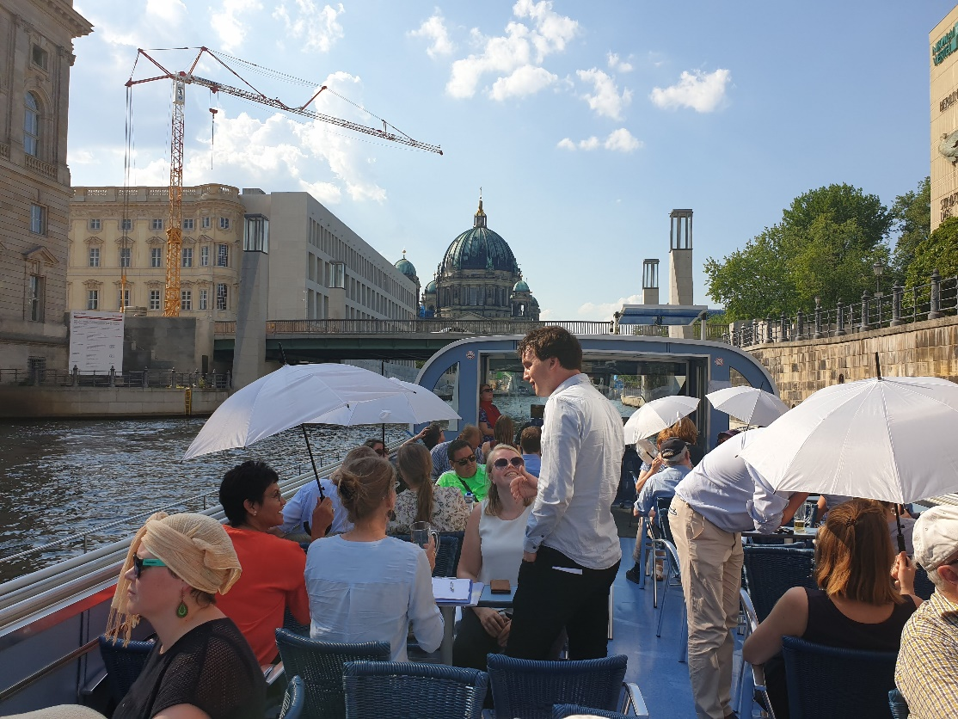
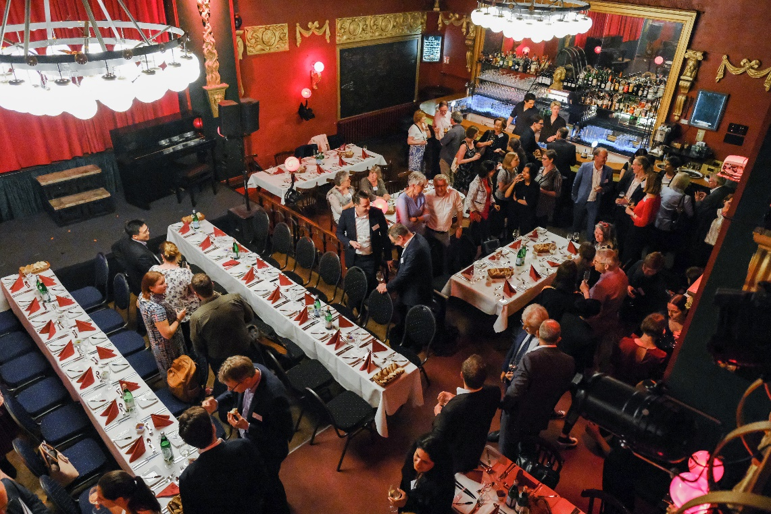
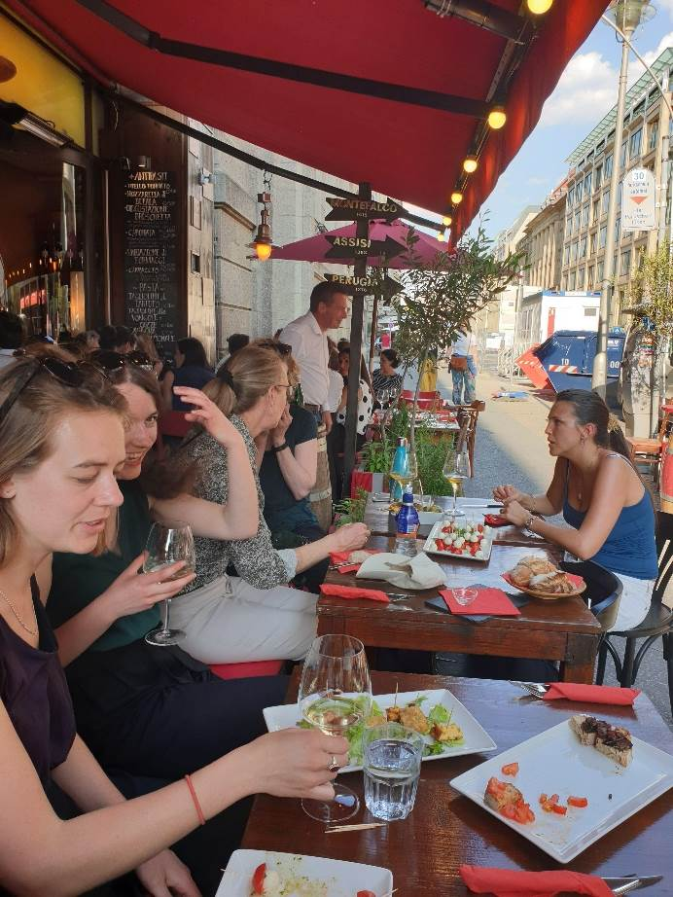
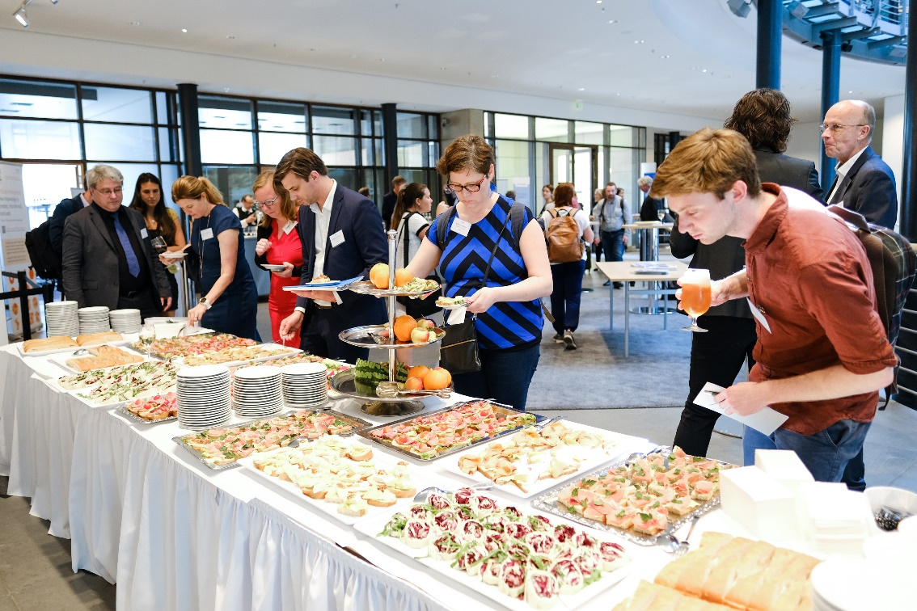
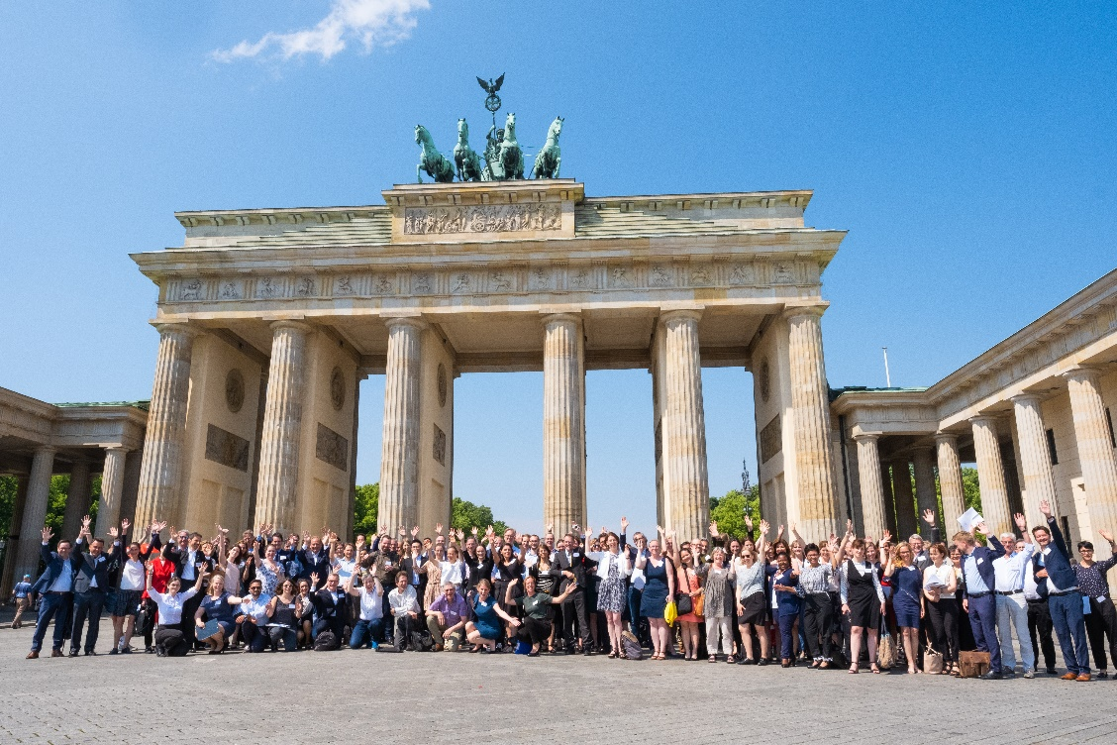

Slide 60
Thank you very much!
Anika Duut van Goor

Slide 61
What do we need?
Transformation

Slide 62
And so:

Slide 63
And of course:

Slide 64
Institutional Structures for Societal Impact of Science
24-27 May, 2022
David Phipps Assistant Vice-President of Research Strategy & Impact, Office of Research Services, York University, Canada
#Instruc22

Slide 65
Institutional Structures for Societal Impact of Science
24-27 May, 2022
Introduction on Institutional Support for Impact
Wilfred Mijnhardt, Executive Director of the Erasmus Research Institute of Management, the Netherlands
Instigating Cultural Change
Toni Caro, Impact Capacity Building Expert
Strengthening the Institutional Infrastructure, Support & Training
Kathryn Graham, Executive Director of Performance Management & Evaluation at Albert Innovates, Canada
Monitoring Impact as part of the Institution’s Support
Kathryn Graham, Executive Director of Performance Management & Evaluation at Albert Innovates, Canada
Societal Impact & Science Funding
Britt Holbrook, Associate Professor in the Department of Humanities, New Jersey Institute of Technology, United States
Overview of Day 2
#Instruc22

Slide 66
Institutional Structures for Societal Impact of Science
24-27 May, 2022
Introduction on Demonstrating, Assessing & Communicating Impact
Simon Kerridge, Adjunct Lecturer at Johns Hopkins University & Independent Research Consultant, United Kingdom
Impact Assessment to serve your Institution
Simon Kerridge, Adjunct Lecturer at Johns Hopkins University & Independent Research Consultant, United Kingdom
Current & Emerging Approaches to Impact Evaluation – Part I
Juan D. Rogers, Professor of Public Policy at the School of Public Policy, Georgia Institute of Technology, United States
Current & Emerging Approaches to Impact Evaluation – Part II
David Budtz Pedersen, Professor of Science Communication and Director of the Humanomics Research Centre in Copenhagen, Denmark
Communicating Impact
David Budtz Pedersen, Professor of Science Communication and Director of the Humanomics Research Centre in Copenhagen, Denmark
Overview of Day 3
#Instruc22

Slide 67
Institutional Structures for Societal Impact of Science
24-27 May, 2022
Dynamic Universities for a Transforming World
Assignment Preparations
Participant Presentations
Final Words & Questions
Reception!
Overview of Day 4
#Instruc22

